Slide 1









Employee Performance Analysis Using Excel
PRESENTED BY: HARISH RAJ G.K
REGISTER NO : 312219328
DEPARTMENT : B.COM ACCOUNTING AND FINANCE 3RD YR
COLLEGE. :S.A. COLLEGE OF ARTS AND SCIENCE

Slide 2
PROJECT TITLE
EMPLOYEE PERFORMANCE ANALYSIS USING EXCEL

Slide 3
AGENDA
1.Problem Statement
2. Project Overview
3.End Users
4.Our Solution and Proposition
5. Dataset Description
6. Modelling Approach
7. Results and Discussion
8.Conclusion

Slide 4
PROBLEM STATEMENT
There is a need to assess and address diversity and inclusion within the employee population based on gender, race, and marital status.
The data shows varying performance ratings across different employees and job functions. Understanding the root causes behind these discrepancies is crucial.
The mix of full-time, part-time, contract, and temporary employees, along with different termination types, suggests possible issues with employee retention and job satisfaction.
Different business units and locations are represented in the data. Analyzing performance and employment trends across these units can identify areas of strength and those needing improvement.
Ensuring that the data reflects compliance with employment regulations, especially in terms of classifications, pay zones, and employee types.

Slide 5




PROJECT OVERVIEW
[Employee Performance Improvement and Pay Zone Optimization]
Conduct an initial review to clean and preprocess the data for consistency and accuracy. This includes handling missing or ambiguous entries in performance scores, employee status, and termination descriptions.
Assess the effectiveness of different business units by analyzing employee performance, job functions, and pay zones to identify high-performing and underperforming areas.
Analyze the performance scores and ratings of employees across different business units, job functions, and employment types to identify trends and areas for improvement.
Evaluate the relationship between supervisors and their team's performance ratings to determine if certain supervisors are associated with better or worse outcomes.

Slide 6


WHO ARE THE END USERS?
Human Resources (HR) Department
Department Managers (Sales & Production)
Senior Leadership/Executives
Employees
Finance/Compensation Teams

Slide 7
OUR SOLUTION AND ITS VALUE PROPOSITION
Filtering - Remove missing values.
Conditional Formatting - Blanks, Background Color Shading, Data Bars, Values.
Data Filtering and Sorting - Identify specific employee performance groups, such as those with exceeds, needs improvement and fully meets.
Pivot table - Summary of employee performance under their employee Id.
Graphs - Final Report with Trend line.

Slide 8
DATASET DESCRIPTION
EMPLOYEE ID: Unique identifier for each employee in the organization.
FIRST NAME: The first name of the employee.
PAY ZONE: The pay zone or salary band to which the employee's compensation falls.
DEPARTMENT TYPE: The broader category or type of department the employee's work is associated with.
CURRENT EMPLOYEE RATING: The current rating or evaluation of the employee's overall performance.

Slide 9
MODELLING
DATA SET: Kaggle, Employee dataset.
FEATURE SELECTION: Slicer, Conditional Formatting, Designing.
DATA CLEANING: Missing values, Irrelevant data, Correct Errors, Remove Unnecessary Columns and Rows.
PIVOT TABLE: Employee ID, First Name, Performance Score.
CHART: Report of Employee Performance based on their Employee Id is represent in Values and Performance Score presented as Column Chart.

Slide 10
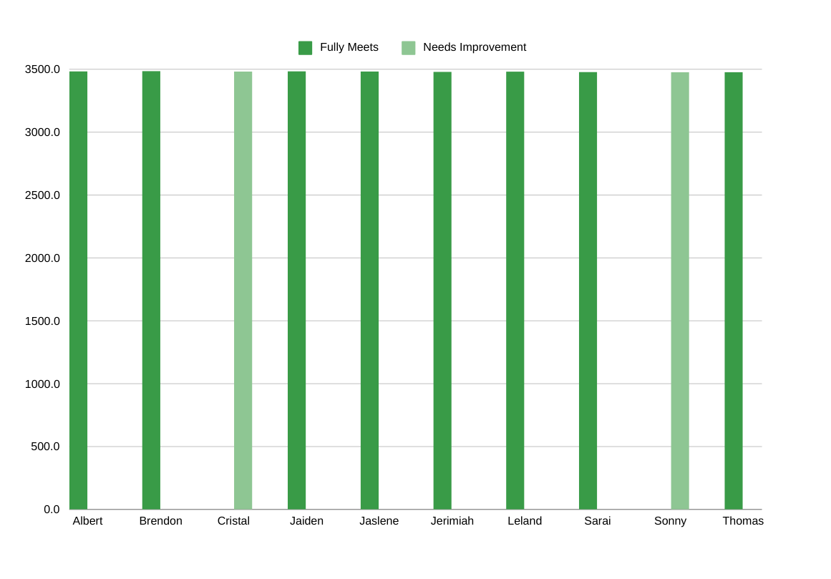
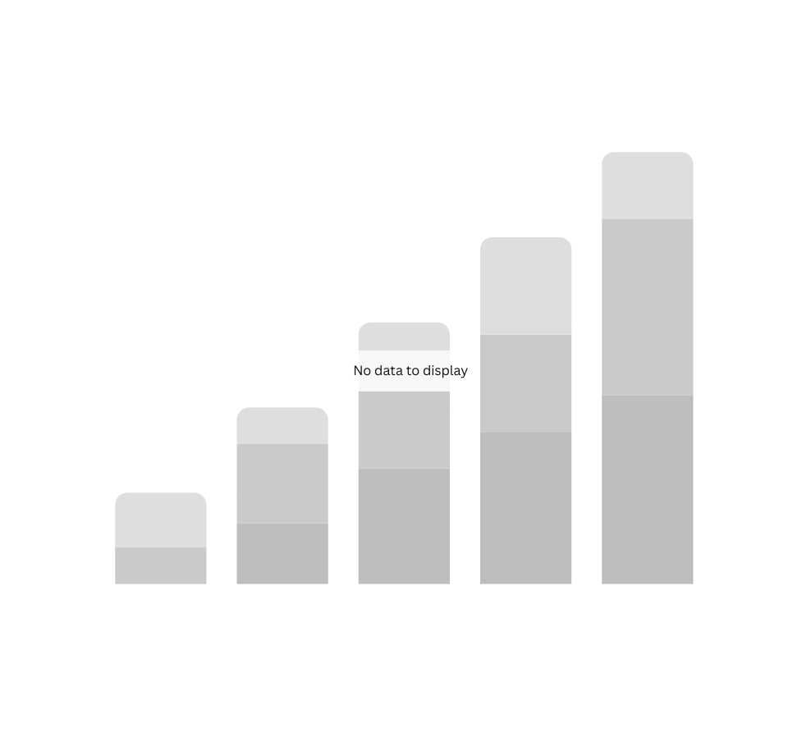
RESULTS

Slide 11
CONCLUSION
Based on the performance analysis, recommend strategies to address performance discrepancies and enhance overall employee performance.
Findings on supervisor effectiveness will inform targeted training programs to improve management practices and support employee development.
Insights will be gained into how supervisor effectiveness impacts employee performance, which could inform training and development programs for supervisors. Recommendations will be made to leverage successful practices identified in high-performing units and address challenges in underperforming areas.
Improve onboarding processes for future start employees based on their performance and integration needs, ensuring smoother transitions.
The data will be assessed for compliance with employment regulations, ensuring that all employee classifications and pay zones align with legal standards.

Slide 12

REFERENCE

